Slide 1

Multiple Regression on ABC Company Employees’ Salaries
By : Tamrat Workineh

Slide 2
Multiple Regression on ABC Company Employees ‘Salaries
Hello Everyone:
In this presentation discussion is made on Multiple Regression on ABC Company Employees’ Salaries dataset:
Topic of discussion:
Overview of the dataset
Project’s Objectives:
Dataset Exploration
methodology of study
Result and Interpretation
Summary and Conclusion
Limitations and Next Step
References and contributions

Slide 3
Overview of the ABC- Company Dataset
The ABC Company has 500 employees. The dataset of the company originally contains 500 rows and 13 columns. After data wrangling, it is reduced to 500 rows and 6 columns
Variable Description :
Emp_ID : Employee _ID
Emp_Age : Age of employees
Experience: Work experience of the employees
Sex : Male or Female Employee
Education in Year: Educational Qualification (Diploma/Degree / Masters )
Annual_Rate : Annual salary of employee
Note :
To explore the relationship between the independent variables (age, experience, educational background and sex) from now on called ‘Features’ and Annual Rate from now on called ‘target ‘dependent variable.

Slide 4
The Project Objective
This project emphasizes the use of regression analysis to examine a relationship between multiple features and a target variables.

Slide 5
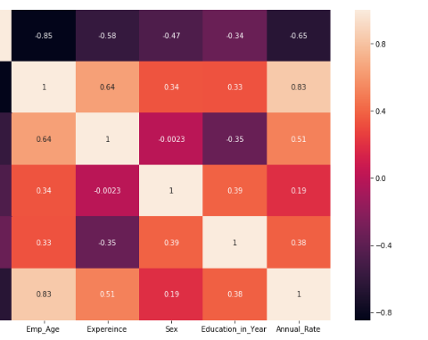
Dataset Exploration
The ABC Company’s Dataset Heatmap:
Fig 1: Heatmap : The heatmap shows the plosive correlation as we go up to lighter color

Slide 6
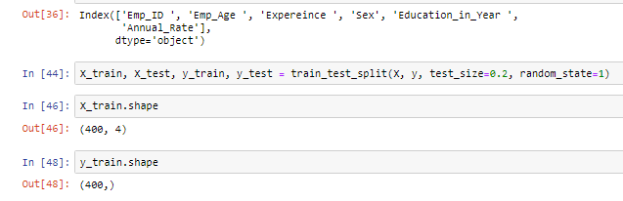
Train-Test Split technique was used to split the dataset into two subsets 80% to 20 % training and divided to contains X and Y trains 400 data rows each whereas X and Y test 100 rows, and to better evaluate the performance of the linear regression model.
Methodology of study
Train-Test Split Technique

Slide 7
Model:

Slide 8
From the regression equation, We know that :
,
where is the predicted /targeted value; X₁ through X_{p} are p distinct Predictor variables,b₀ is the Y intercept and b₁ through b_{p} are the estimated regression coefficients

Slide 9

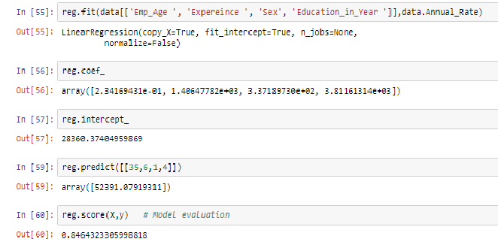
Based on the given equation: A dataset with 500 rows and six columns were Analyzed:
A trained data set was fitted in to the model to predict the regression model:

Slide 10
Results and Interpretations
A multiple regression model was calculated substituting the formula with the coefficients and Y-intercept to preditct the target employees’ annual rate. Based on numerical values of age, sex, work experience and education predictors. The accuracy of the model is found to be 0.85.
Next Steps:
This regression model has not examined the dataset exhaustively. There is a plan to apply different models and compare and examine to come up with more accurate model related to the dataset after covering the remaining topic in the course.

Slide 11
References and contributions:
https://www.valuebasedmanagement.net/methods_regression_analysis.html
https://www.statisticssolutions.com/sample-size-formula

Slide 12
Thank You

